Slide 1
SAP BTP Architect Training
Day 5
Anubhav Oberoy
www.AnubhavTrainings.com
Follow excellence with sheer passion

Slide 2


DISCLAIMER
The training content and delivery of this presentation is confidential, and cannot be recorded, or copied and distributed to any third party, without the written consent of Anubhav Trainings

Slide 3
Agenda – Day 5
01
05
Introduction to HANA Cloud
MTA applications with module
02
05
Connecting to HANA Cloud Instance
Application Security
05
06
Cloud Transport management and CI/CD
Application Security

Slide 4
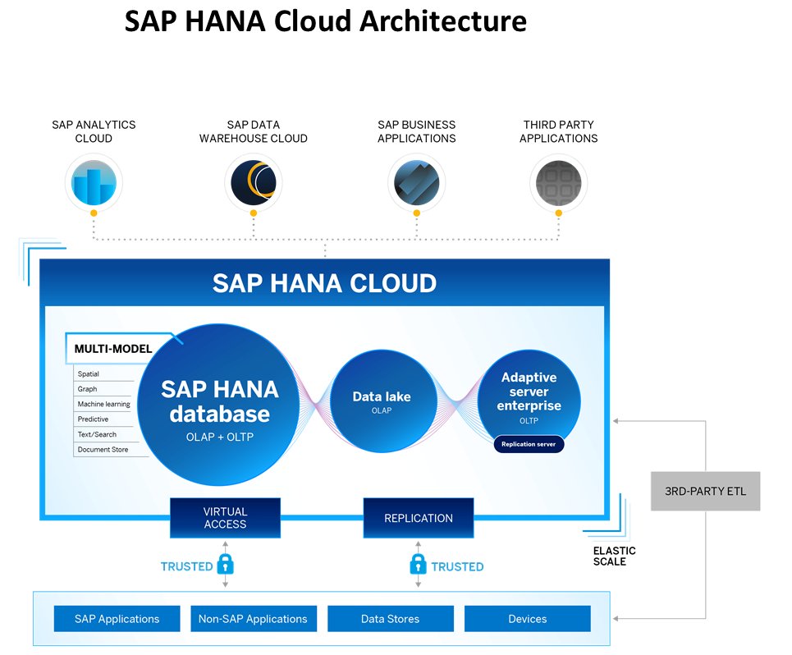
Introduction to HANA Cloud
SAP HANA Cloud is a fully managed, in-memory, cloud database as a service (DBaaS). It is the cloud-based data foundation for SAP Business Technology Platform. With SAP HANA Cloud you can create, run, and extend new and existing applications.
SAP HANA Cloud includes a number of software components. The core component is SAP HANA Database, but other components can be added at any time, such as a data lake.
Key Components of SAP HANA Cloud
There are four key components of SAP HANA Cloud:
SAP HANA Cloud, SAP HANA Database
In-memory database with built-in advanced analytics (spatial, graph, text, etc.)
SAP HANA Cloud, data lake
Store and query large data sets and most file types
SAP HANA Cloud, adaptive server enterprise
Support for extreme –performance transactional applications
SAP HANA Cloud, adaptive server enterprise replication
Bi-directional real time data replication across databases

Slide 5
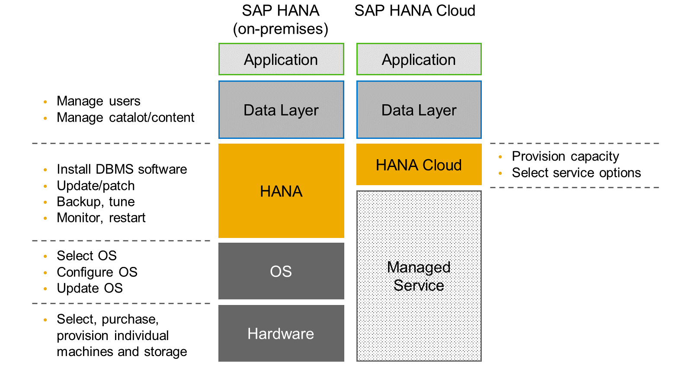
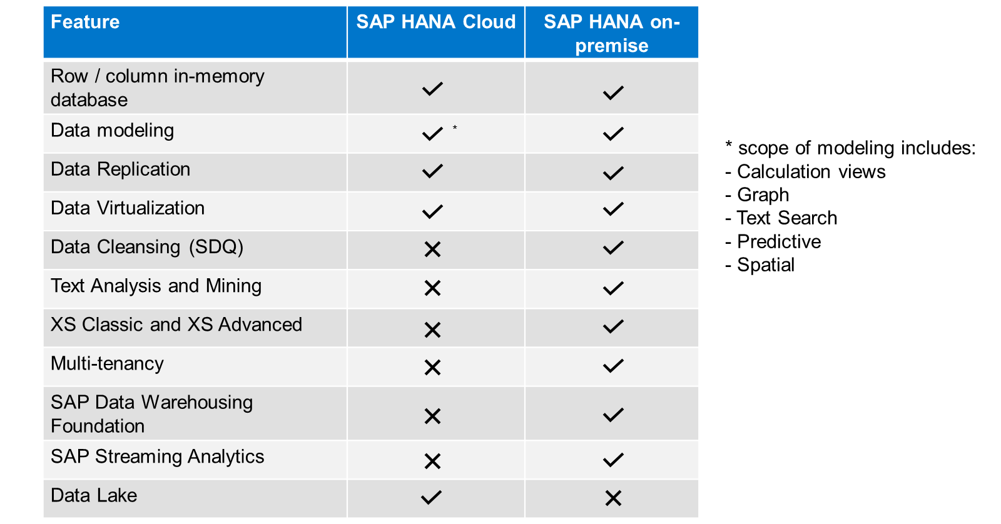
HANA Cloud v/s On-premise
Feature Differences
SAP HANA Cloud compares very closely with SAP HANA on-premise in terms of features but there are some differences.

Slide 6
What is Schema in HANA
Schema – Is a mandatory database object of database which stores other database objects.
It’s a logical separation of database objects.
It is home of all the runtime object
Security
BW
ekko
ECC
ekko
S/4HANA
ekko
Non-SAP
SAP HANA 600GB
SCBW
ekko
ECC001
ekko
SAPS4C
ekko
MIG
ekko
SYS

Slide 7
HDI Container
An HDI Container is also a schema. But it is managed differently from a normal schema.
Schema -- How its created?
Manually create it in BTP
Application Managed HDI Container (You as developer ONLY work with App, App will talk to HANA to create and manage this schema to store/read data internally)
You cant access HDI Container using HANA Studio (Deprecated tool), We can use new SAP HANA Database Explorer, SAP HANA WebIDE for OP or BAS to access HDI Container.
HDI -- Who creates it?
There is a new service in SAP HANA called SAP HDI (HANA Deployer Infrastructure) which is just a microservice responsible to managing the container. HDI Deployer is a component which is used to talk to this service from our app.

Slide 8
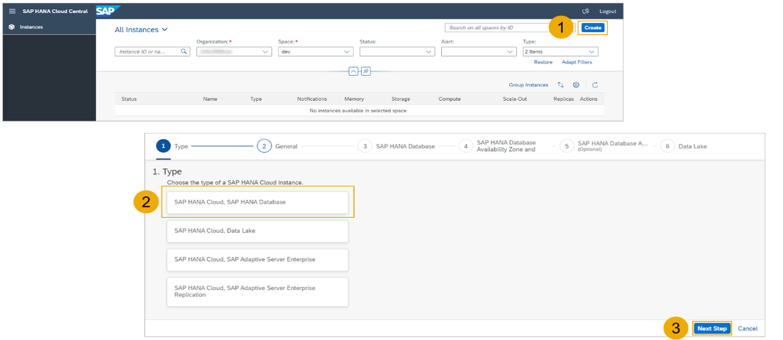
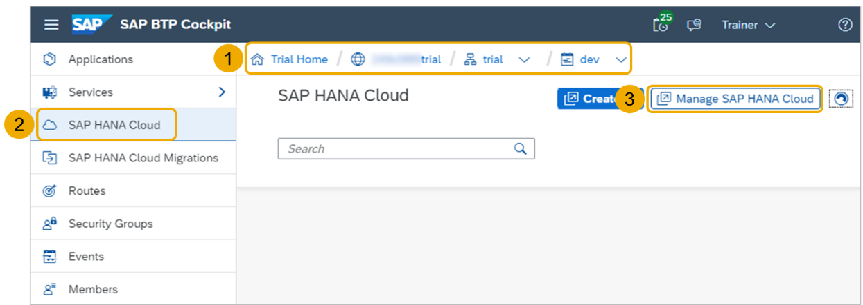
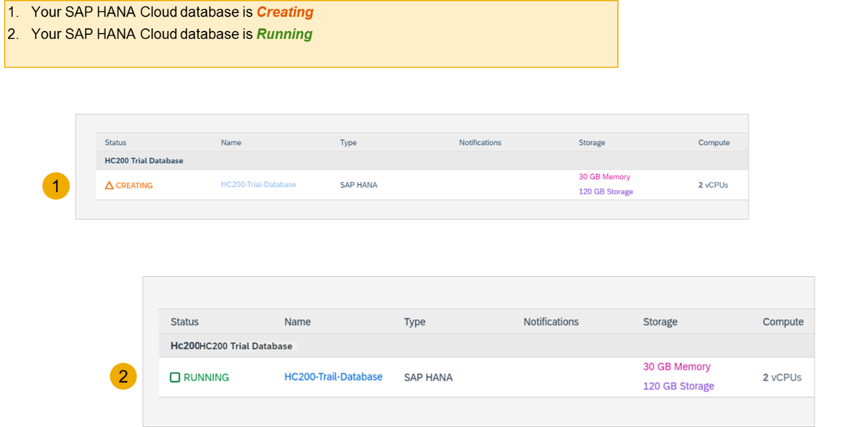
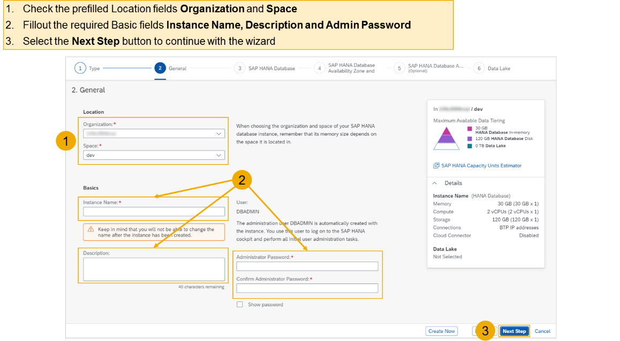
Hands on - Create HANA Cloud Instance
Login to your trial and navigate to your dev space
Select SAP HANA Cloud
Select the Manage SAP HANA Cloud button to start the SAP HANA Cloud Central
Select the Create button to start the wizard
Select the SAP HANA Cloud instance Type to create
Select the Next Step button to continue

Slide 9
Hands on – HANA Cloud Integration
Pre-requisites
Check the version of CDS (which must be > 2.0) cds –v
Start a HANA cloud instance in SAP BTP
Main steps
Add hana configuration to our app, which tell cap framework that the default db is now hana – cds add hana
2. Add the hana specific deployment format name to our project under cds section as below inside package.json file "hana":{
"deploy-format":"hdbtable"
}
3. Since the first step added the hdb node module, we need to install it. Run npm install
4. We need to perform a build, which will create all the hana specific files which will be deployed to HANA cloud. cds build --production
5. We need to login to cloud foundry from BAS – cf login
6. Finally we need to deploy the DB and everything to SAP HANA Cloud – cds deploy --to hana:batman
7. We fixed issues related to excel format of HANA and changed the size of field bankid for employee, redo the build and deploy
8. If deployment worked, a new file cdsrc-private.json gets created automatically, this file contain the information about which container in SAP BTP HANA Cloud to connect to. And the private key is stored in this file.
9. Provide the credentials which will be used to connect database, start using cds watch --profile hybrid
"credentials": {
"database": "batman-key"
}

Slide 10
Hands on : Deploy Application to BTP
First add the mta.yaml file, MTA – multi-target application which is an advance version of manifest.yml file which we used in past.
We use SAP provided CLI for MTA, this is pre-installed in BAS, tool is called mbt
First we run command cds add mta
We will add our UI module to the mta.yaml file manually, copy the srv entry and add the ui module.
- name: cappo-ui
type: nodejs
path: app
parameters:
buildpack: nodejs_buildpack
build-parameters:
builder: npm-ci
requires:
- name: srv-api
Inside the app folder, add the package json using npm init and add the app router module npm install @sap/approuter.
Add the start script "start": "node node_modules/@sap/approuter/approuter.js"
Add the xs-app.json, provide the routes and the end points
Open MTA editor and configure srv-api destination
Right click on mta.yaml file and choose build mta archieve this will create a mtar file for us

Slide 11
Hands on – Adding Security
Created a new resource in mta.yaml file for xs-uaa backing service with following properties
name == cappo-xsuaa
service == xsuaa
service-plan == application
path == ./xs-security.json
Add the dependency of this newly created xs-uaa service to our microservices in require section
Create the xs-security.json file from sap btp documentation and adapt file to have 2 roles – Viewer and the Admin role. The viewer role also have an attribute called bank name which will be for row level security.
Add 3 node modules which will help in security configuration for our app
npm install passport ; npm install @sap/xssec ; npm install @sap/xsenv
5. We need to inform app router to contact xsuaa to mandate the use of JWT token. In xs-app.json file
Change authenticationMethod : route and add "authenticationType": "xsuaa"
6. We need to secure our service resources to only allow authenticated user, hence we need to add an annotation requires: 'authenticated-user’
We need to tell system that if we run app locally (development environment) in BAS tool, use mock strategy for testing security. After deployment to CF (production environment) we use JWT strategy.

Slide 12
Security Profile
Additionally we configure demo local users for testing purpose. Under cds → requires section inside package.json file we add the strategy
"auth":{
"[production]":{
"strategy": "JWT"
},
"[development]":{
"strategy": "mock",
"users": {
}
}
}
8. Now we can test our app using cds watch --profile hybrid

Slide 13
CEO
US Manager
Anubhav
Ananya
All Employee
Who are from USA
All Employee
Name | BankName
A | X
B | X
C | Y
D | Y
E | Z
F | X
G | Y

Slide 14
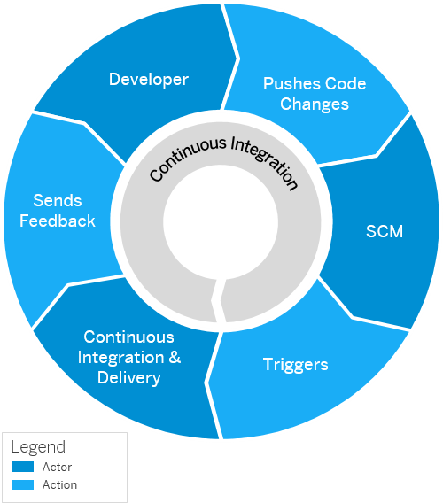
Continuous Integration and Delivery (CI/CD)
Configure and run predefined continuous integration and delivery (CI/CD) pipelines that automatically build, test, and deploy your code changes to speed up your development and delivery cycles.
Continuous integration (CI) describes a software development process, in which various team members integrate their contributions frequently into a single main line. Before each integration, the changes are verified through builds and automated testing. Thereby, you can detect errors as quickly as possible and prevent integration problems before completing the development.
The continuous delivery (CD) concept expands on the one of continuous integration. It adds the aspect that any change that has successfully passed the tests is immediately ready to be deployed to production, both from a technical and a qualitative point of view.

Slide 15
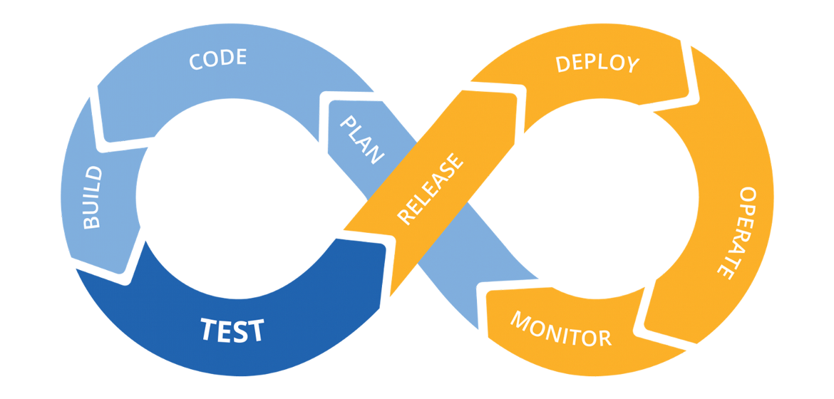
Hands on: Continuous Integration

Slide 16
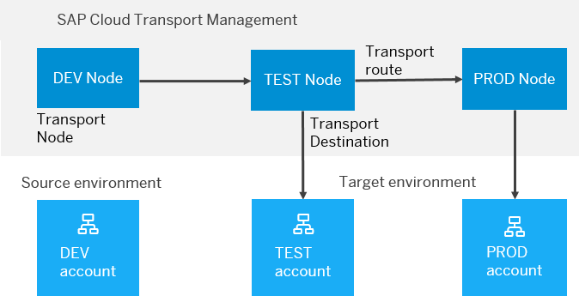
BTP Cloud Transport Management
SAP Cloud Transport Management service lets you manage software deliverables between accounts of different environments (such as Neo and Cloud Foundry), by transporting them across various runtimes. This includes application artifacts as well as their respective application-specific content.
SAP Cloud Transport Management service adds transparency to the audit trail of changes so that you get information about who performed which changes in your production environment, and when they did it. At the same time, the service enables a separation of concerns: For example, a developer of an application or of SAP Cloud content artifacts can trigger the transport of changes in a development subaccount, while the resulting import into the test, and production subaccount is handled by a central operations team.

Slide 17

Hands on SAP BTP Cloud Transport

Slide 19

What We Did
Let’s Summarize

Slide 20

www.anubhavtrainings.com
Thank You
End of Day 5

Slide 21


We’re committed to empower you to be
#FutureReady
through powerful training solutions.
We build the workforce of the future.
250+
Corporate Clients
50,000+
Learners Trained
25000+
Learners Placed
FREE WEBINARS
Sign up for free webinars with industry experts every fortnight!
Enroll Now!
Contact us today!
https://anubhavtrainings.com

